Slide 1
Warm- UP:
On an index card you need to write your list of perfect squares #1-15, 20, 25, and 30 WITHOUT LOOKING AT YOUR NOTES!

Slide 2
8th Grade
Square & Cube Roots Vocabulary:
Perfect Squares- numbers that when you take the square root, you get a whole number. For example, √4 = 2, √36 = 6
Squared- A number being raised to the 2nd power; a number being multiplied by itself one time. Ex: x2 = (x)(x) Ex: 52 = (5)(5) = 25
Square Root:
When you take the square root of a number, you are looking for a number that when you multiply a number by itself, it gives you the number inside the radical.
√81 = what number when you multiply it by itself, or square it, you get 81?

Slide 3
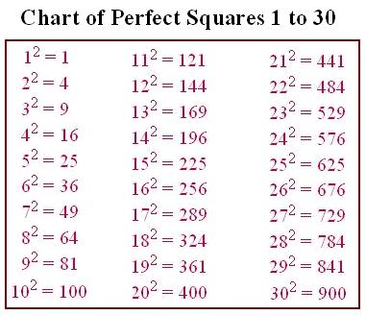
8th Grade
Perfect Squares:

Slide 4
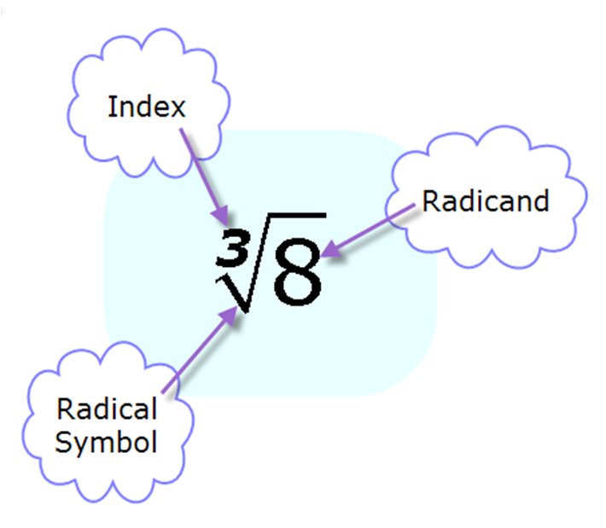
8th Grade
Symbols and their meanings.

Slide 5
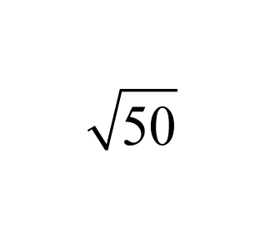
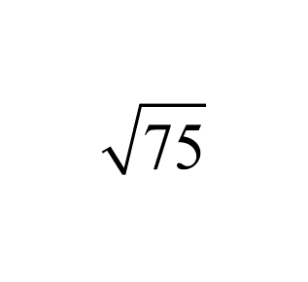
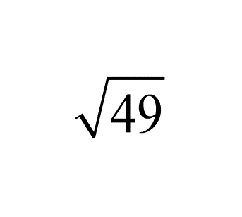

Slide 6
8th Grade
Identify
√4 √9 √144
radicand:_____
index:_____
value:______
radicand:_____
index:_____
value:______
radicand:_____
index:_____
value:______

Slide 7
8th Grade
Identify- Your Turn
√36 √100 √121
radicand:_____
index:_____
value:______
radicand:_____
index:_____
value:______
radicand:_____
index:_____
value:______

Slide 8
Review
concept 1
Fill in the following:
-2 x -2 =
2 x 2 =
So the √4 is ...
8th Grade
When you take the square root of a positive number, there are always two answers: one + and one -
Example 2:
√49 =
√16 =

Slide 9
How do we "undo" a square?
concept 2
Example 1:
Solve for x.
x2 = 36
8th Grade
You Try:
1.) x2 = 9 2.) x2 = 100
3.) x2 = 144

Slide 10
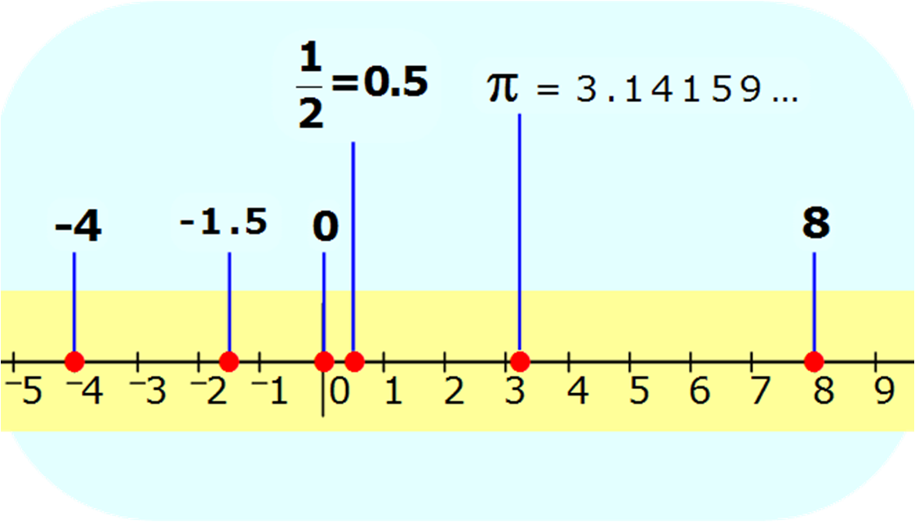
8th Grade
Placing Values on the Number Line

Slide 11
8th Grade
Placing Values on the number line
√4 √16 √12 √40
-10
-9
-8
-7
-6
-5
-4
-3
-2
-1
0
1
2
3
4
5
6
7
8
9
10

Slide 12
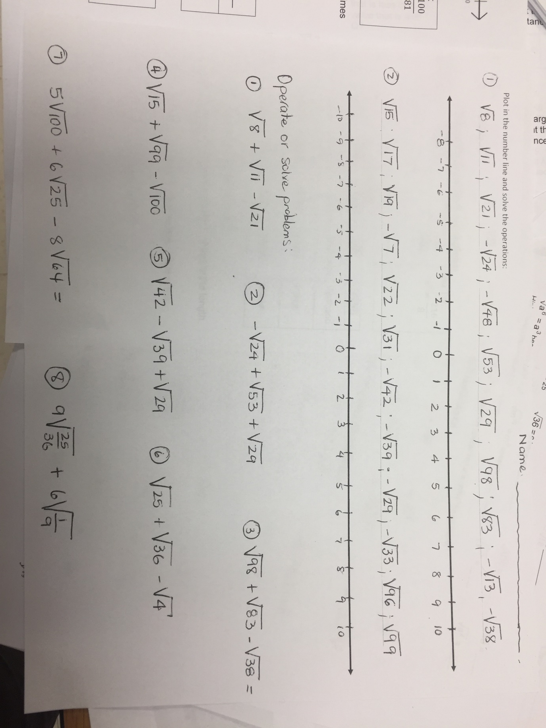
Your Turn
8th Grade
-10
-9
-8
-7
-6
-5
-4
-3
-2
-1
0
1
2
3
4
5
6
7
8
9
10

Slide 13
Warm Up
4√100 + 10√64
2√36 - 4√4
-10√25 - √81

Slide 14
Taking the Square Root of Fractions
concept 3
8th Grade
Example 1:
Solve for x.
x2 =
Example 2:
Solve for x.
x2 =
4
9
25
64
You Try:
1.) x2 = 2.) x2 =
36
49
100
81

Slide 15
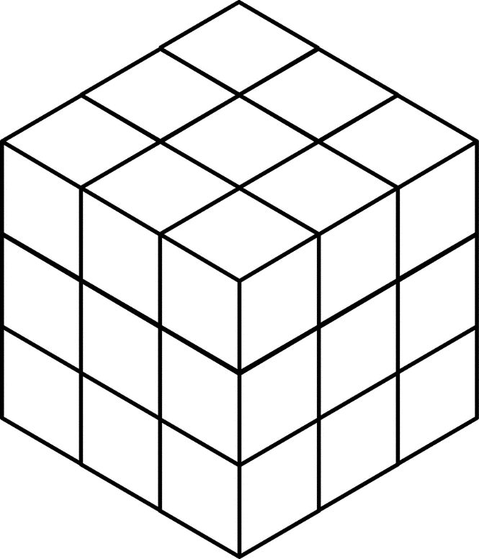
8th Grade
concept 4
Cube Root: a number that when multiplied by itself three times creates a cubic value (which is the number inside the radical.)
Examples:
√16 = √4(4) = 4
√25 = √5(5) = 5
∛8 = ∛2(2)(2) = 2
∛64 = ∛(4)(4)(4) = 4

Slide 16
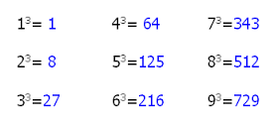
Perfect Cubes:
8th Grade

Slide 17
How do we "undo" a cube?
concept 5
Example 1:
Solve for x.
x3 = 8
8th Grade
You Try:
1.) x3 = 125 2.) x3 = 64
3.) x3 = 27

Slide 18
Cube Roots Practice:
8th Grade
1.) ∛1 =
2.) ∛27 =
3.) ∛1000 =

Slide 19
Taking the Cube Root of Fractions
concept 6
8th Grade
Example 1:
Solve for x.
x3 =
Example 2:
Solve for x.
x3 =
1
8
27
64
You Try:
1.) x3 = 2.) x3 =
125
1000
216
8

Slide 20
8th Grade
Identify
∛1 ∛125 ∛64
radicand:_____
index:_______
value:______
radicand:_____
index:_______
value:______
radicand:_____
index:_______
value:______

Slide 21
Your Turn- Identify
8th Grade
∛27 ∛8 ∛729
radicand:_____
index:_______
value:______
radicand:_____
index:_______
value:______
radicand:_____
index:_______
value:______

Slide 22
Word Problem Practice
8th Grade
1) What is the value of x when 49 = x2?
2) A square garden has an area of 64 ft2. What is the length of one side of the garden?

Slide 23
8th Grade
3) A cube has a volume of 216 cubic inches. What is the length of one of its edges?
4)
What is the sum of
and
?

Slide 24
8th Grade
Finding square roots and cube roots dealing with fractions.
√64/144 ∛216/8
√169/196 ∛64/125

Slide 25
EOG Word Problem Practice (Part 1):
Example 1:
1. What is the sum of all the integers between the √19 and √77?
Example 2:
2. What is the sum of all the integers between the √60 and √200?

Slide 26
Your Turn:
3. What is the sum of all the integers between the √3 and √27?
4. What is the sum of all the integers between √30 and √90?

Slide 28
5. What is the sum of all the integers between √150 and √230?
Your Turn:
6. What is the of all the integers between √45 and √75?

Slide 29
EOG Word Problem Practice (Part 2):
Example 1:
On a number line, let point P represent the largest integer value that is less than √407 . Let Point Q represent the largest integer value that is less than -√67. What is the distance between P and Q?

Slide 30
EOG Word Problem Practice (Part 2):
Example 2:
On a number line, let point P represent the largest integer value that is less than √146 . Let Point Q represent the largest integer value that is less than -√23. What is the distance between P and Q?

Slide 31
EOG Word Problem Practice (Part 2):
Your Turn #1:
On a number line, let point P represent the largest integer value that is less than √50 . Let Point Q represent the largest integer value that is less than -√72. What is the distance between P and Q?

Slide 32
EOG Word Problem Practice (Part 2):
Your Turn #2:
On a number line, let point P represent the largest integer value that is less than √125 . Let Point Q represent the largest integer value that is less than -√8. What is the distance between P and Q?

Slide 33
EOG Word Problem Practice (Part 2):
Your Turn #3:
On a number line, let point P represent the largest integer value that is less than √37 . Let Point Q represent the largest integer value that is less than
-√43. What is the distance between P and Q?

Slide 34
EOG Word Problem Practice (Part 3):
Example 1:
The area of a square garden is 36 ft2. What is the perimeter of the garden?

Slide 35
EOG Word Problem Practice (Part 3):
Example 2:
A cube has a volume of 8 ft3. What is the AREA of one of the faces of the cube?
`

Slide 36
EOG Word Problem Practice (Part 3):
Example 3:
John has two square tables. The first table has an area of 625 square inches,which is 400 square inches more than the area of the second table. What is the length of sides of John's second table?

Slide 37
EOG Word Problem Practice (Part 3):
Example 4:
4. The surface area of a cube is 486 cm2. What is the height of the cube?

Slide 38
EOG Word Problem Practice (Part 3):
Your Turn:
1. The area of a square garden is 81 ft2. What is the perimeter of the garden?
2. A cube has a volume of 64 ft3. What is the AREA of one of the faces of the cube?

Slide 39
EOG Word Problem Practice (Part 3):
Your Turn:
3. John has two square tables. The first table has an area of 900 square inches,which is 275 square inches more than the area of the second table. What is the length of sides of John's second table?
4. The surface area of a cube is 96 cm2. What is the height of the cube?

Slide 40
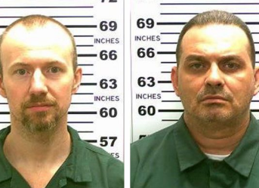
Math 1
The Story of the Great Jail Break:
There once was a place called Incarceratown . The jail in this town was full of criminals. Many of these criminals claimed they had been wrongly accused and given an unfair trial. They maintained their innocence throughout their days in jail.
One day, the innocent victims decided to devise a plan to break out of jail. First, they decided that in order to break out, one must have a partner. Second, this partner must be a trustworthy ally in the same cell block so they could work together. Anyone who was unable to find an accomplice was forced to stay in jail until they had formed a pair.
After finding an accomplice and mapping out a plan, the two decided to ‘run for it’ while on the prison yard. The prisoners were running when the guards were suddenly alerted of an attempt to escape. The prisoners made it to the fence as a guard raised his rifle to stop the prisoners.
One prisoner made it through the fence and the other was almost through when a shot rang out. The first escapee looked back to realize his friend and accomplice had been shot in the head and was dead. He was deeply saddened, but continued running to freedom because he realized there was nothing he could do to save his friend.
So, in the end one prisoner escaped and lived (forever on the run from the law) while the other prisoner was fatally wounded and sent to the funeral home for a proper burial.

Slide 41
Math 1
Finding Square Roots of Non-perfect Squares & Cubes:
√80
√54
Example 1:
Example 2:

Slide 42
Math 1
Finding Square Roots of Non-perfect Squares & Cubes:
√40x2y5
√98x3y4
Example 3:
Example 4:

Slide 43
Math 1
Review of Square Root and Cube Roots:
Finding Square & Cube Roots of Non-perfect Squares & Cubes:
Your Turn:
1. √50 2. ∛32
3. √72x4y7 4. ∛54x2y6

Slide 44
Review of Square Root and Cube Roots:
Math 1
Fractional Exponents-
e
exponent/power
x
r
root/index
Examples:
1
2
3
5
5
∛5
(9x)
√(9x)2
=
=
5
3
4
5
=
∜53

Slide 45
Review of Square Root and Cube Roots:
Math 1
Fractional Exponents-
e
exponent/power
x
r
root/index
You Try:
2
3
6
=
3
4
4
=

Slide 46
Review of Square Root and Cube Roots:
Math 1
Negative Fractional Exponents-
e
exponent/power
x
r
root/index
Examples:
2
-2
1
1
1
( )
3
5
=
2
=
4
2
(5 )
(5 )
∛54
3
3

Slide 47
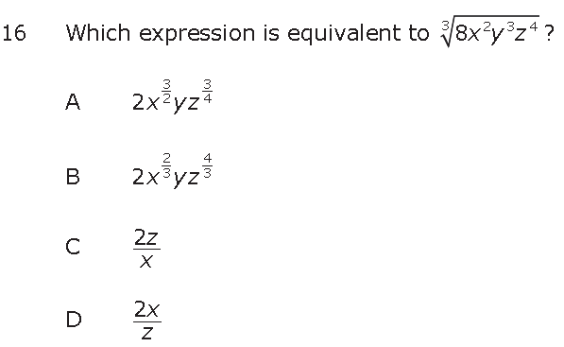
Math 1

Slide 48
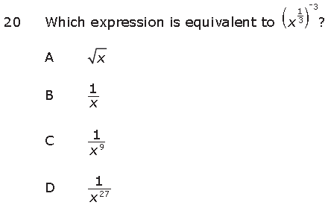
Math 1

Slide 49
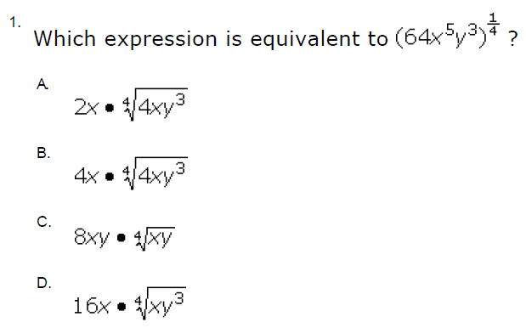
Math 1

Slide 50
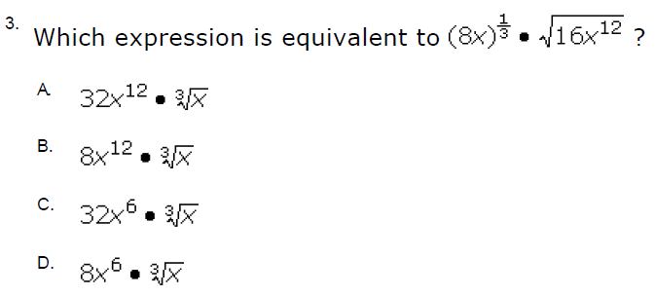
Math 1

